Slide 1
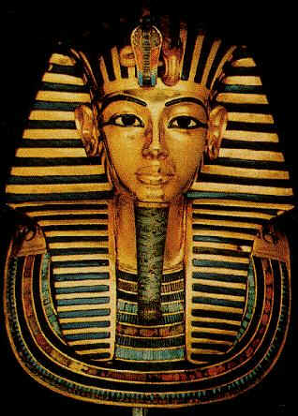
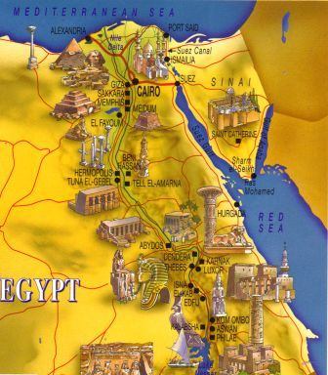
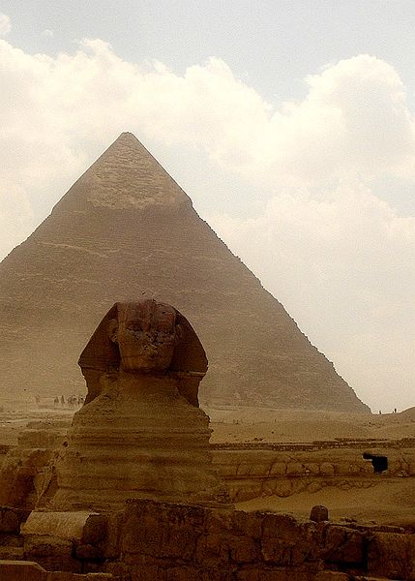
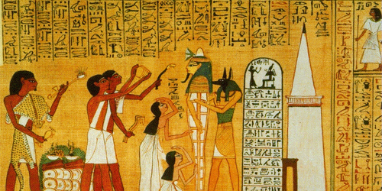
Ancient Egypt

Slide 2
Geography- The Nile River
Begins in the heart of Africa
Longest river in the world at 4,000 miles long
Flows north towards the Mediterranean Sea
Splits before reaching the sea creating an area called a Delta
A delta is a low, watery land formed at the mouth of a river. It is often shaped like a triangle.
There are two cataracts along the river. A cataract is like a rapid.

Slide 3
Geography- Lower and Upper Egypt
Egypt is divided into two areas- Lower and Upper Egypt
Why is Upper Egypt called ‘Upper’ even though it is to the south?
The land around the Nile is fertile
Fertile- where crops and vegetation can grow

Slide 4
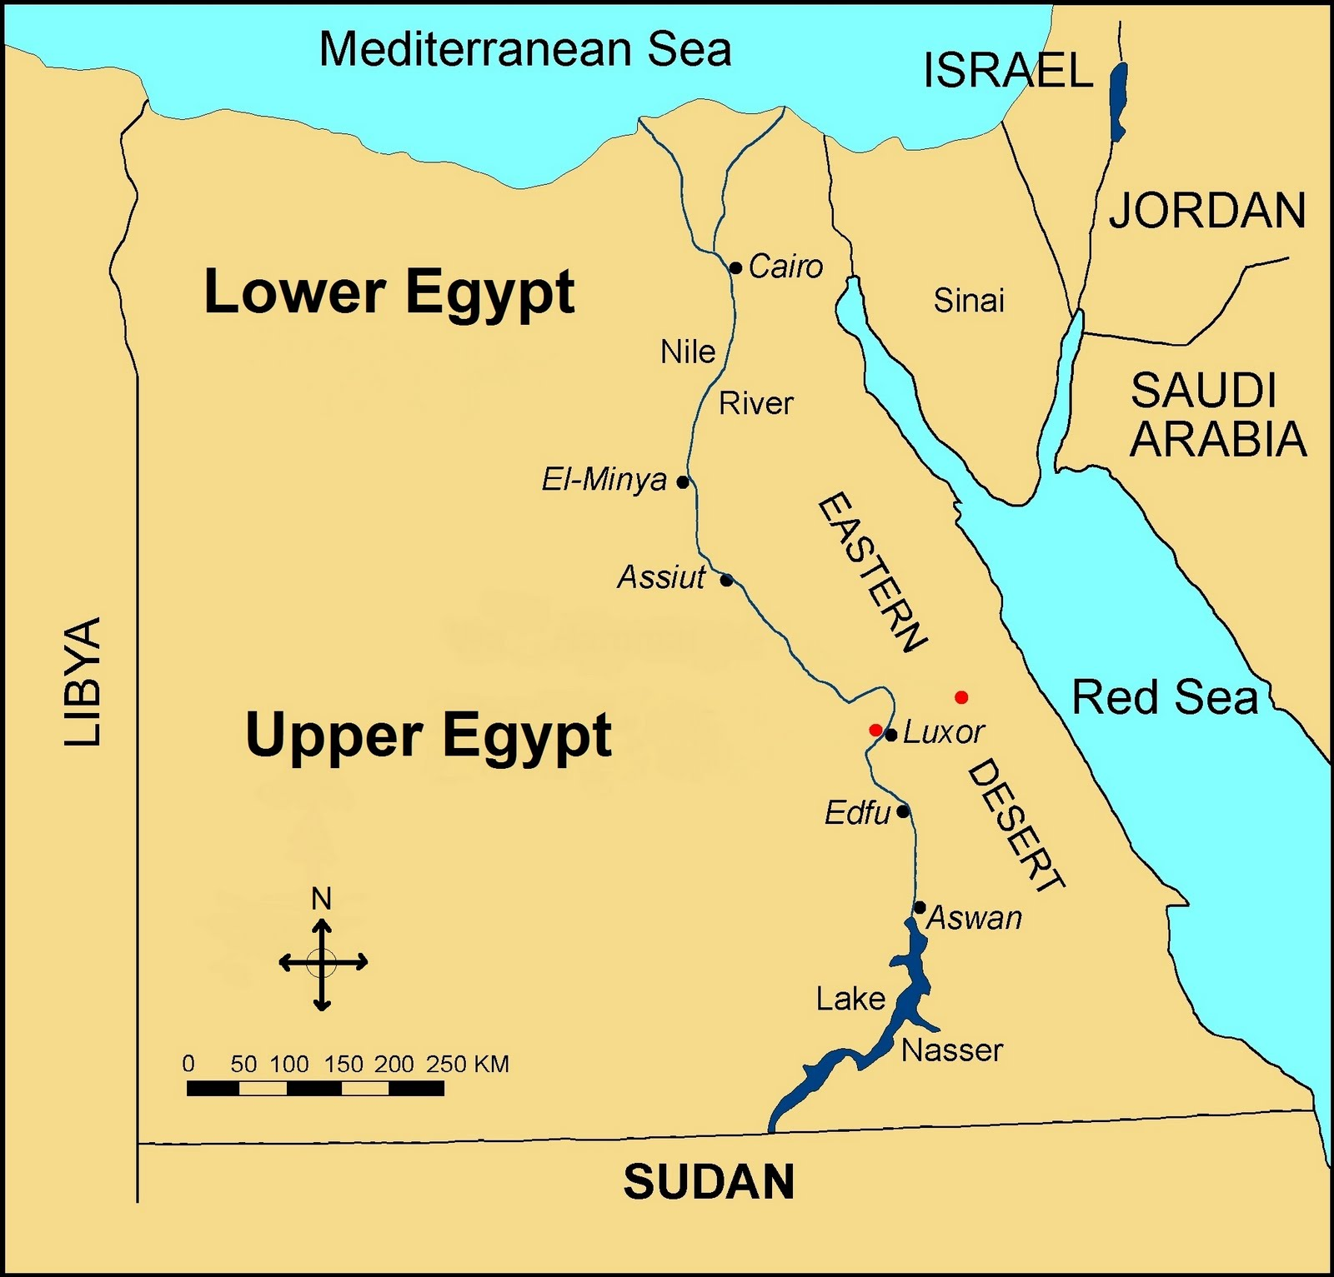

Slide 5
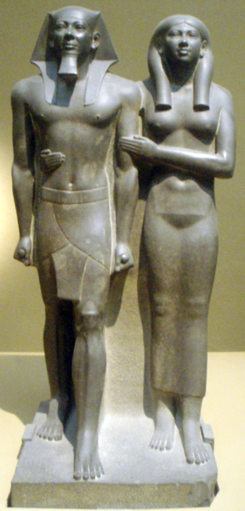
Egyptian History
Divided into three periods: Old, Middle, and New Kingdoms
During these periods there was stability, strong leadership, secure borders, and growth
But, between the periods there were invasions and disorder

Slide 6
Old Kingdom: Age of the Pyramids
2700 B.C. to 2200 B.C.
Powerful rulers called Pharaoh
best known for constructing large pyramids as burial places for Pharaohs.
Egyptians at this time worshipped their pharaohs as Gods – believing that he ensured the annual flooding of the Nile delta to keep the crops growing.
Notes:
Age of the Pyramids
The Old Kingdom collapsed and there was 150 years of disorder

Slide 7
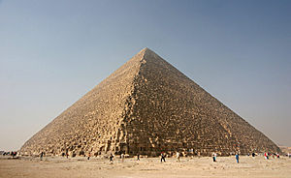

Slide 8
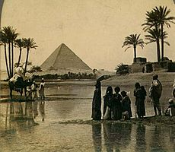

Slide 9
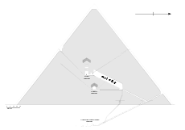

Slide 10
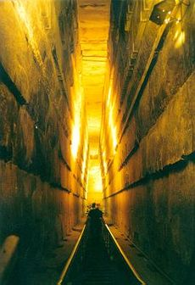

Slide 11
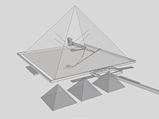

Slide 12
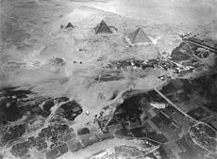

Slide 13
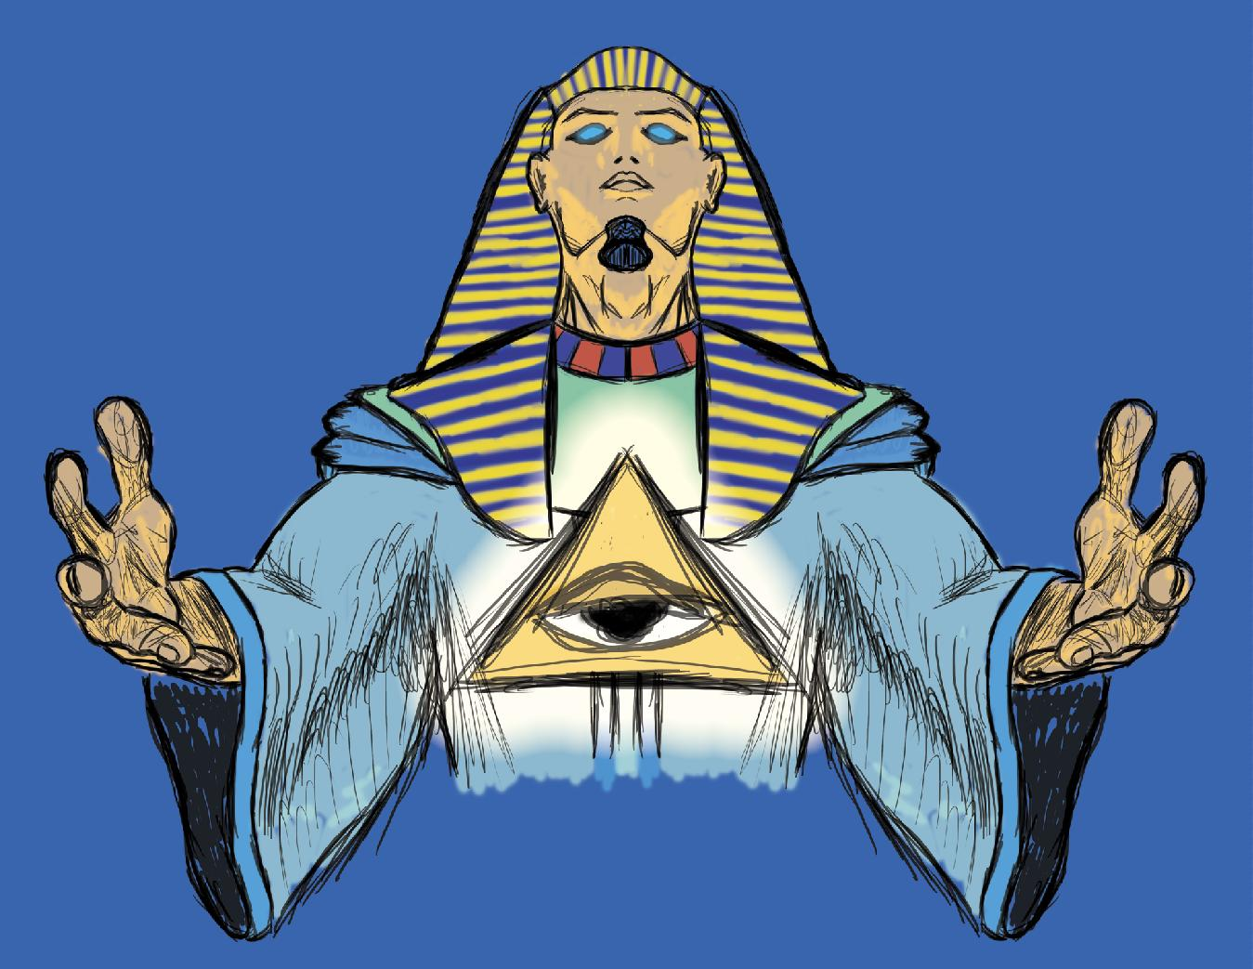
Pharaohs were leaders of different Dynasties
DYNASTY: A family of rulers whose right to rule is passed on with in the family

Slide 14
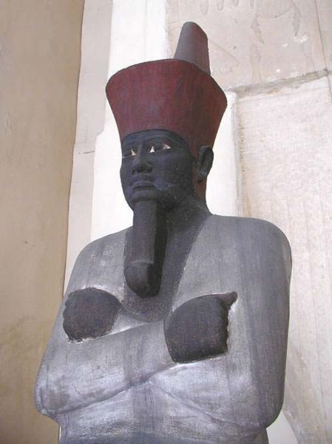
Middle Kingdom
2055 B.C. to 1650 B.C.
Known as the “Golden Age” of stability
These pharaoh’s were concerned for the people
Created projects to help the people
Drained the swamplands to provide thousands of acres of new farmland
Dug a canal from the Nile to the Red Sea to help with trade
Which of these projects would help peasants?

Slide 15
New Kingdom
1550 B.C. to 1070 B.C.
Became the most powerful empire in Southwest Asia
This period had lots of wealth that led to building temples
Hatshepsut was the 1st woman pharaoh
She built a temple called Deir el-Bahri at the Valley of the Kings

Slide 16
Following the Three Kingdoms
Egypt was invaded and unable to reestablish the empire
Pharaoh Cleopatra VII tried to put the empire back together but committed suicide when she was defeated
Egypt was swept up into the expanding Roman Empire

Slide 17
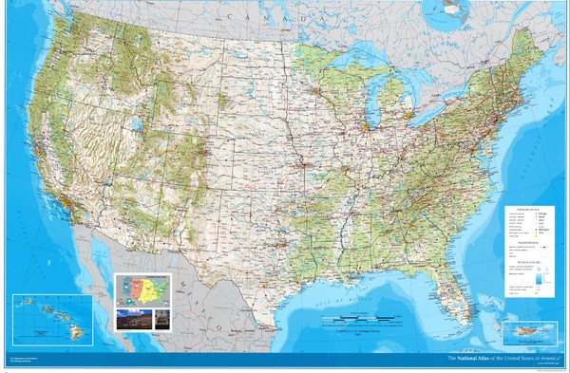

Slide 18
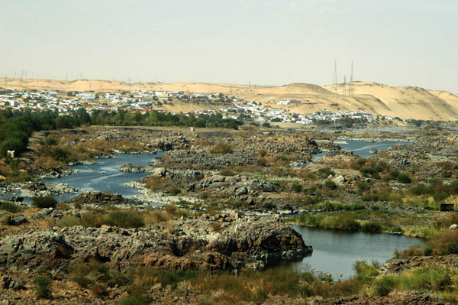

Slide 19
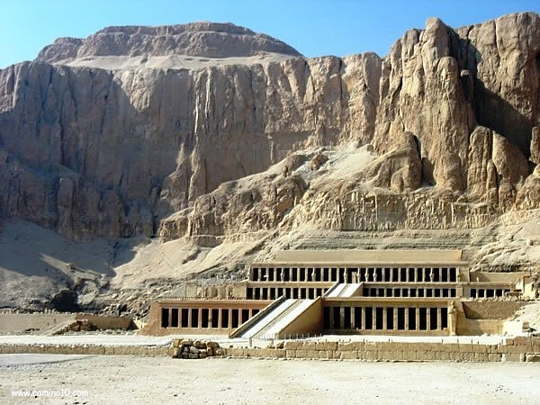

Slide 20
