Slide 1
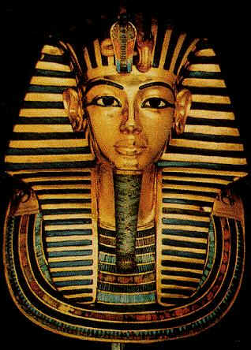
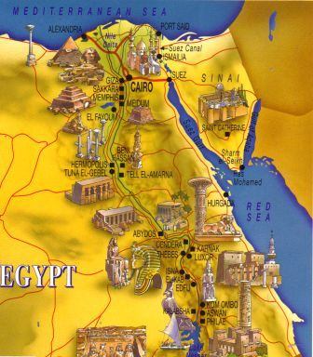
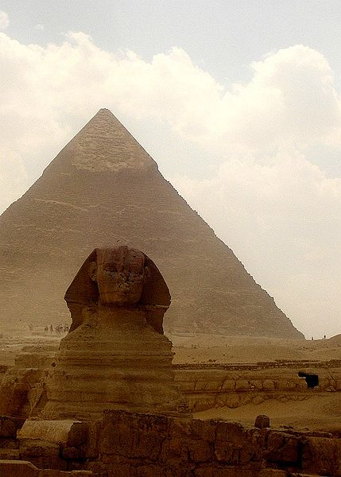
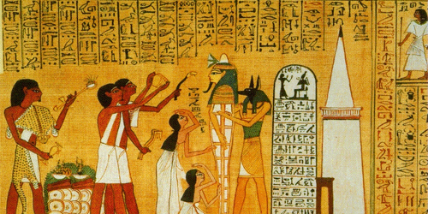
Ancient Egypt

Slide 2
True or False?
It took 35 days to complete the mummification process.
The largest pyramid is as wide as two and a half city blocks.
Most men were only allowed one wife unless the first wife was childless
Peasants could own land.
People are still chasing mummies today.

Slide 3
Pyramids- Part 1
The pyramids were built during the Old Kingdom. Each pyramid was part of a larger complex
Large pyramid for the pharaoh, small pyramid for the family, small flat-roofed houses, mastabas, for the pharaoh’s officials
Each pyramid had tombs filled with chairs, weapons, games, and food
The pharaoh’s body would be preserved so the spirit could return
This process was called mummification and it took 70 days to complete

Slide 4
Pyramids- Part 2
The biggest pyramid is the Great Pyramid of Giza constructed by King Khufu
It covers 13 acres sitting 756 feet wide and 481 feet tall
The pyramid is guarded by a Great Sphinx
A sphinx has the head of a human but the body of a lion

Slide 5
Society- Part 1
Men were the head of the household but the wives were still respected
Most men were only allowed one wife unless the first wife was childless
Woman were in charge of the household and education

Slide 6
Society- Part 2
Egyptian society was broken down into classes that were shaped like a pyramid
At the top was the God-King, the Pharaoh
Next was the nobles and priests who ran the government and managed the land
Then merchants, artisans, scribes, and tax collectors
Merchants traded up and down the Nile River
Artisans built beautiful goods such as stone dishes, gold and silver tools, and paper from papyrus
Most people were peasants and worked the land
The pharaoh owned the land but let subjects use some of the land
The peasants had to pay taxes to the pharaoh in the form of crops and had to serve in the military
Peasants were forced into labor projects such as building the pyramids

Slide 8
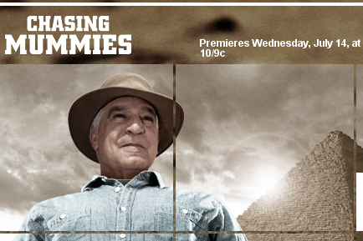
Chasing Mummies

Slide 9
