Slide 1
Geography Dictionary

Slide 2
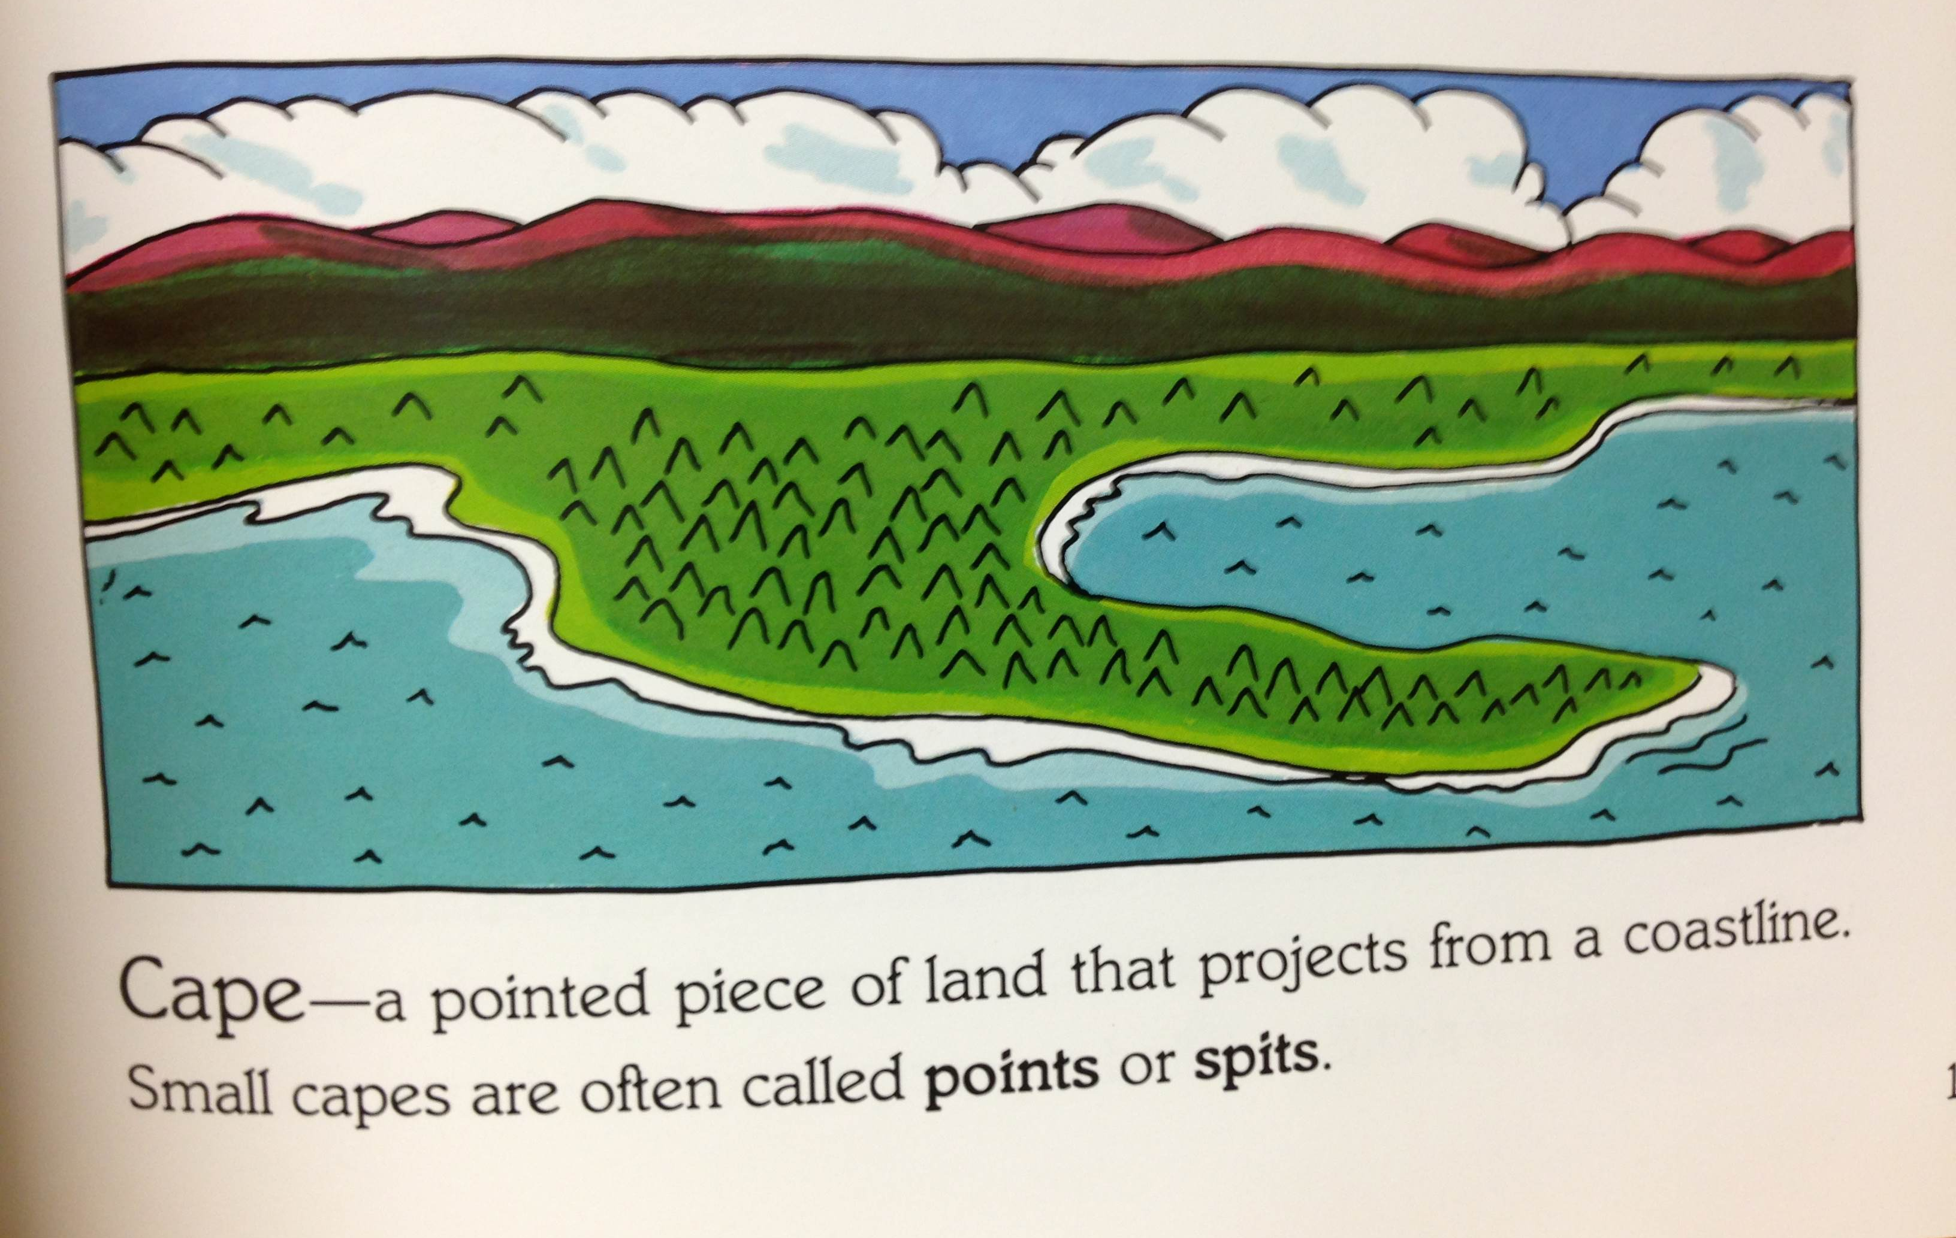

Slide 3
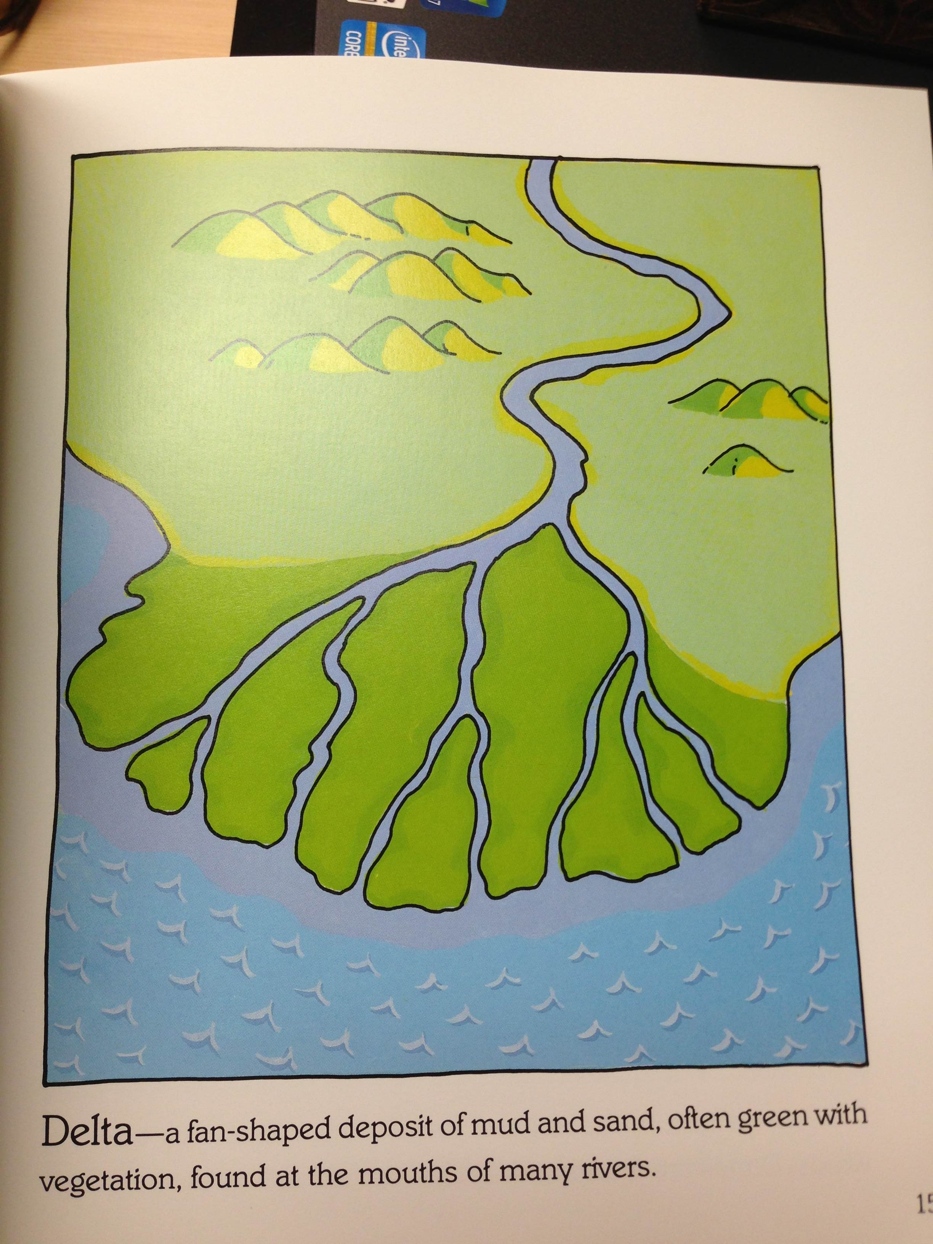

Slide 4
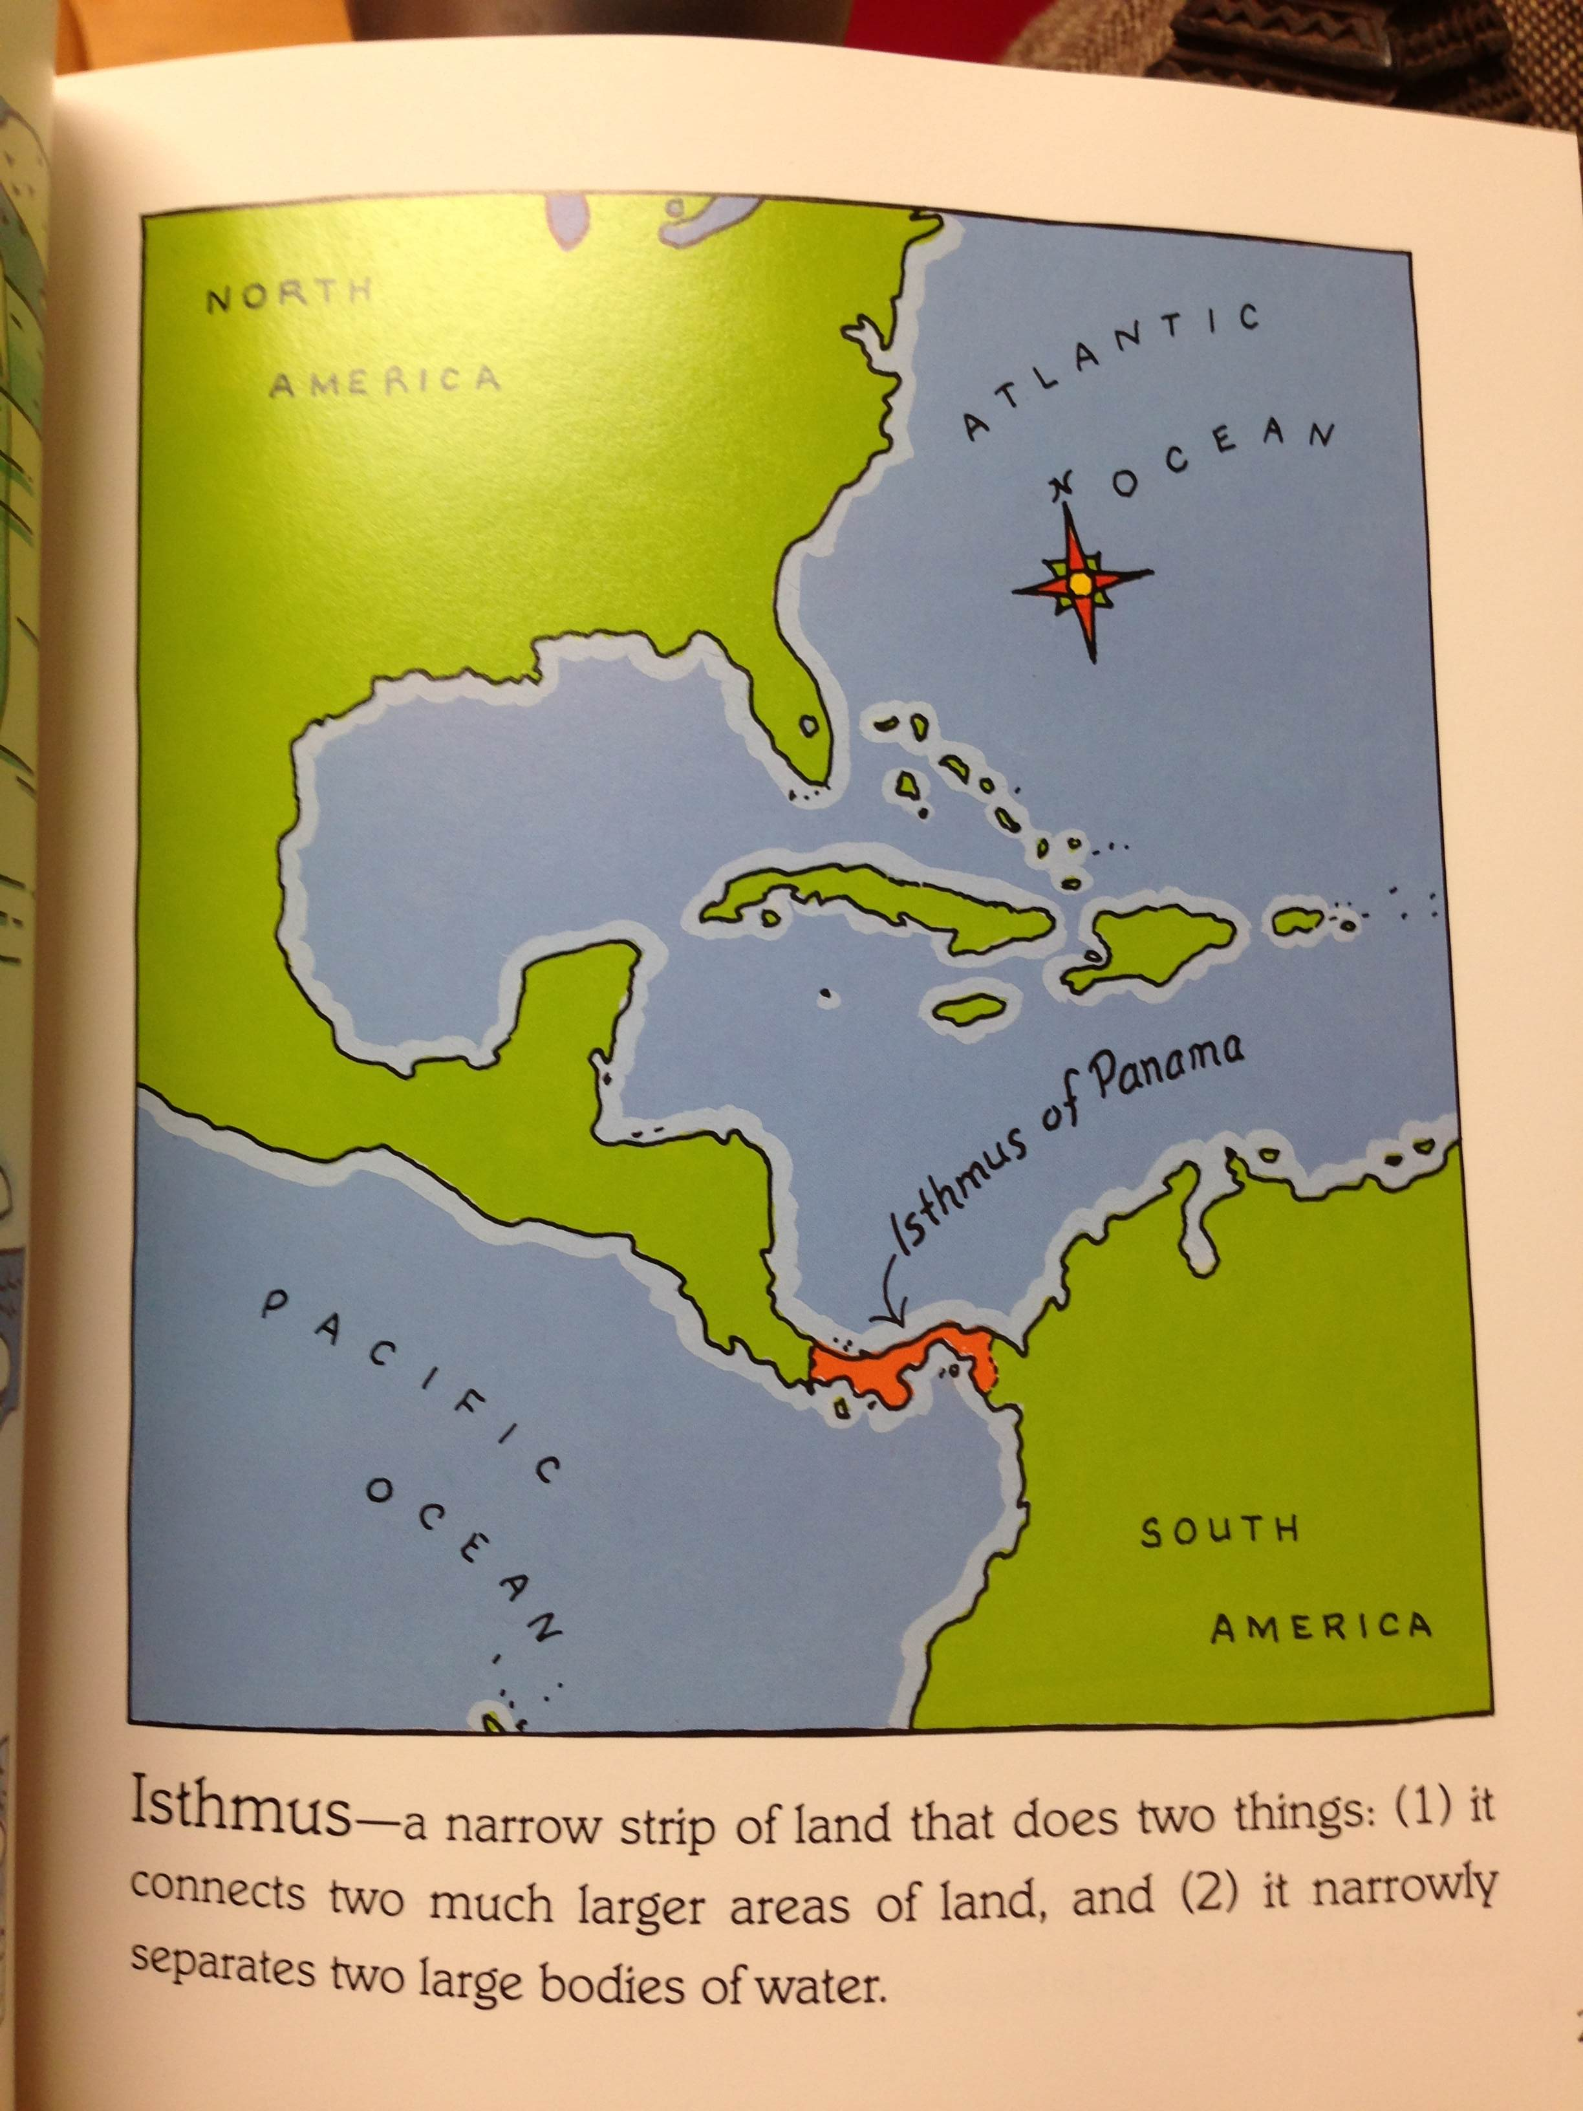

Slide 5
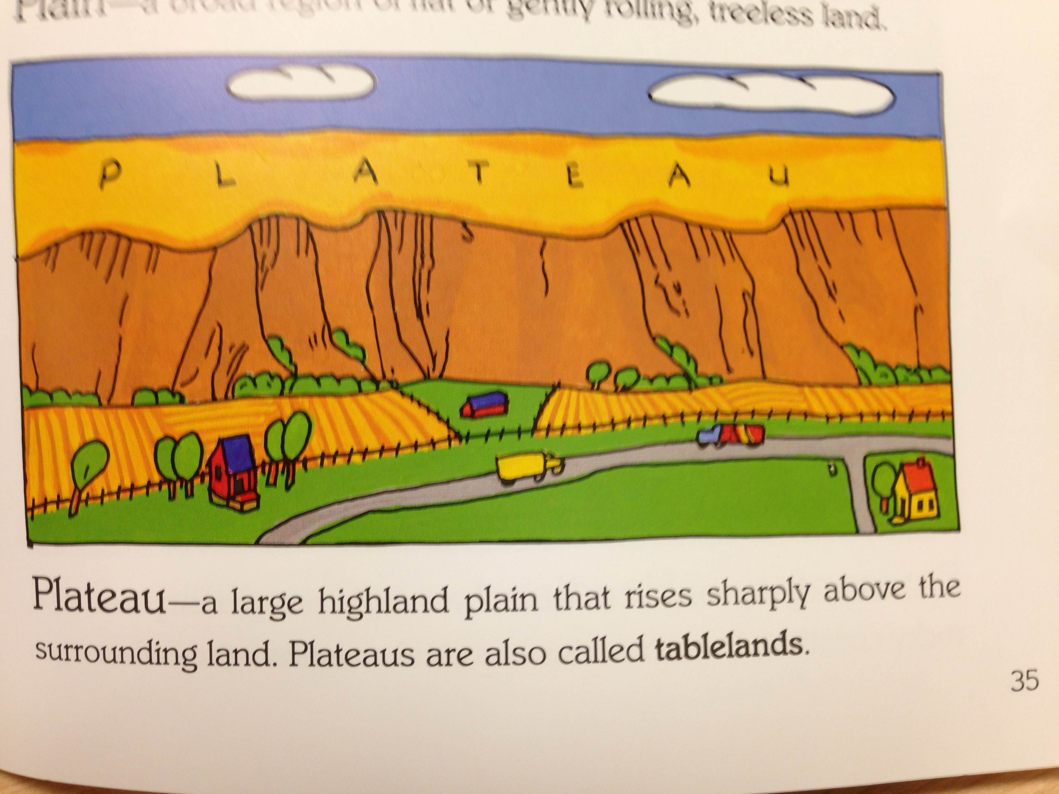

Slide 6
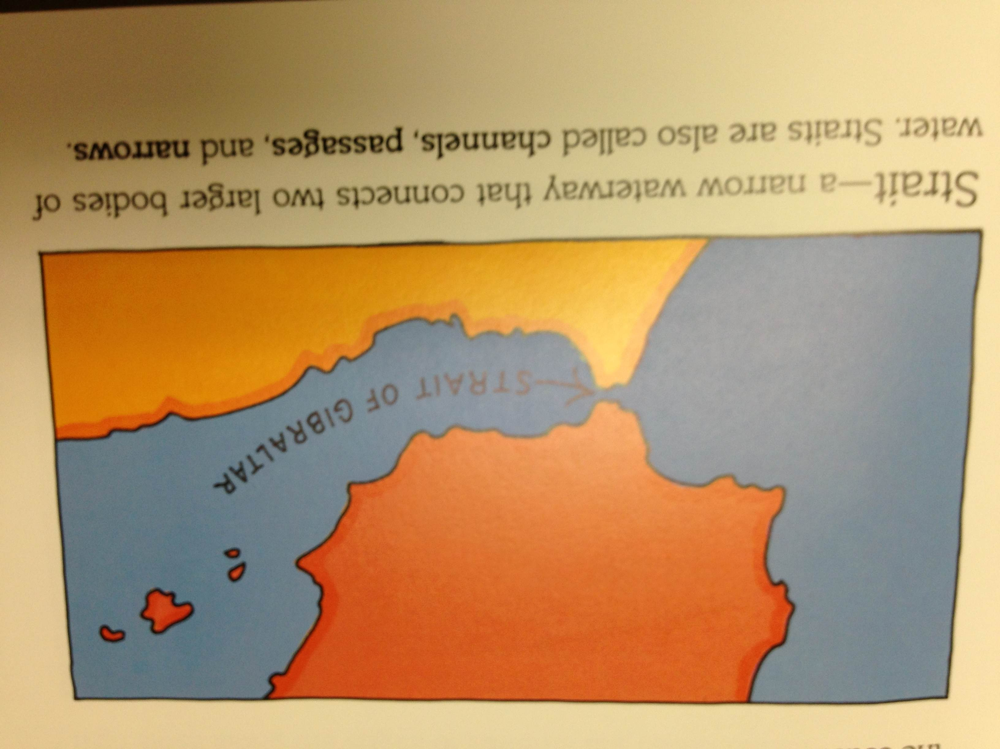

Slide 7
Links
Tributary: http://education.nationalgeographic.com/education/encyclopedia/tributary/?ar_a=1
Basin: http://education.nationalgeographic.com/education/encyclopedia/basin/?ar_a=1
Gulf:
http://education.nationalgeographic.com/education/encyclopedia/gulf/?ar_a=1

Slide 8
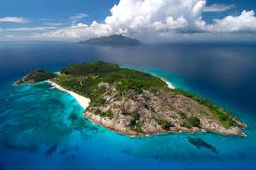
Notes:
Island/Land area, smaller than a continent, completely surrounded by
water

Slide 9
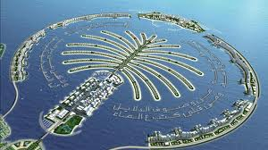

Slide 10
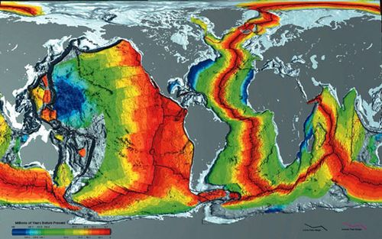
http://www.youtube.com/watch?v=mrSu65Bb9X4
Notes:
Ocean/One of the four major bodies of salt water that surround the
continents

Slide 11
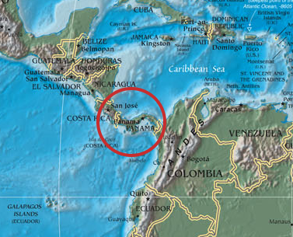
Notes:
Isthmus/Narrow stretch of land with two bodies of water on each side, AND connecting two larger land areas

Slide 12
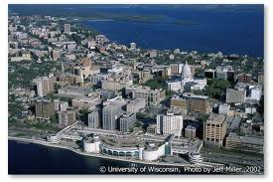

Slide 14
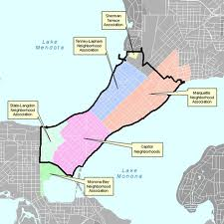

Slide 15
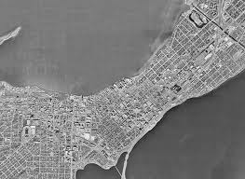

Slide 16
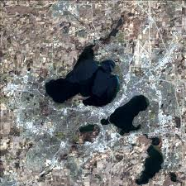

Slide 17
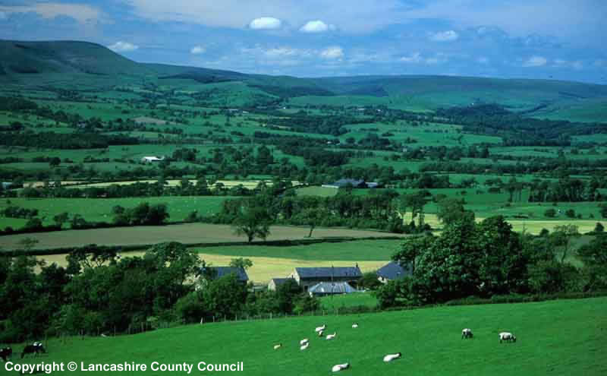
Notes:
Lowland/ Area of land this lower and flatter than the surrounding country

Slide 18
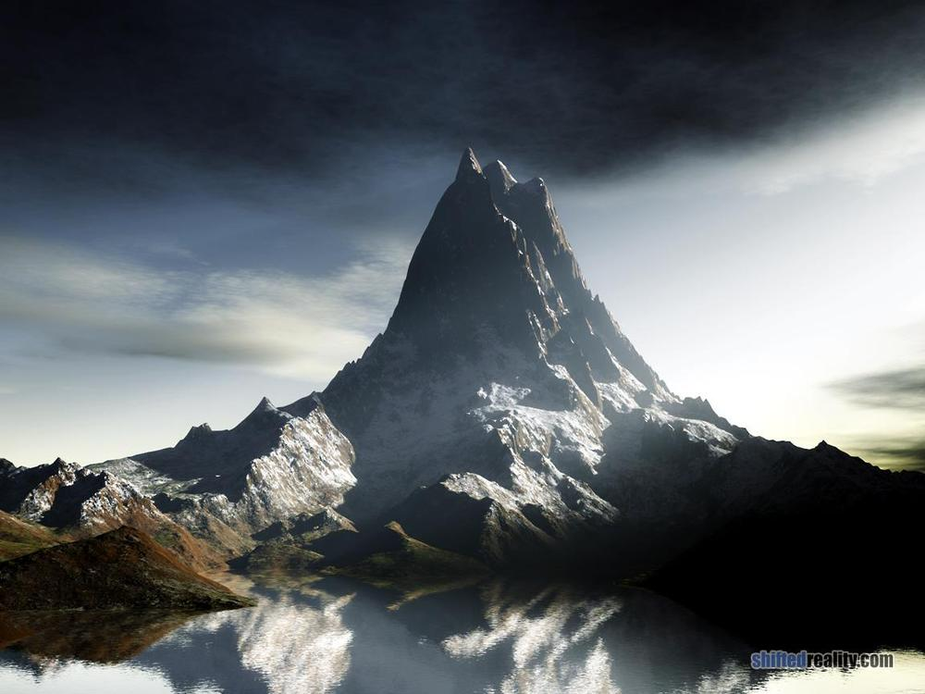
Notes:
Mountain/Land with steep sides that rise sharply (1,000 feet or more)
from surrounding land; generally larger and more rugged than a hill

Slide 19
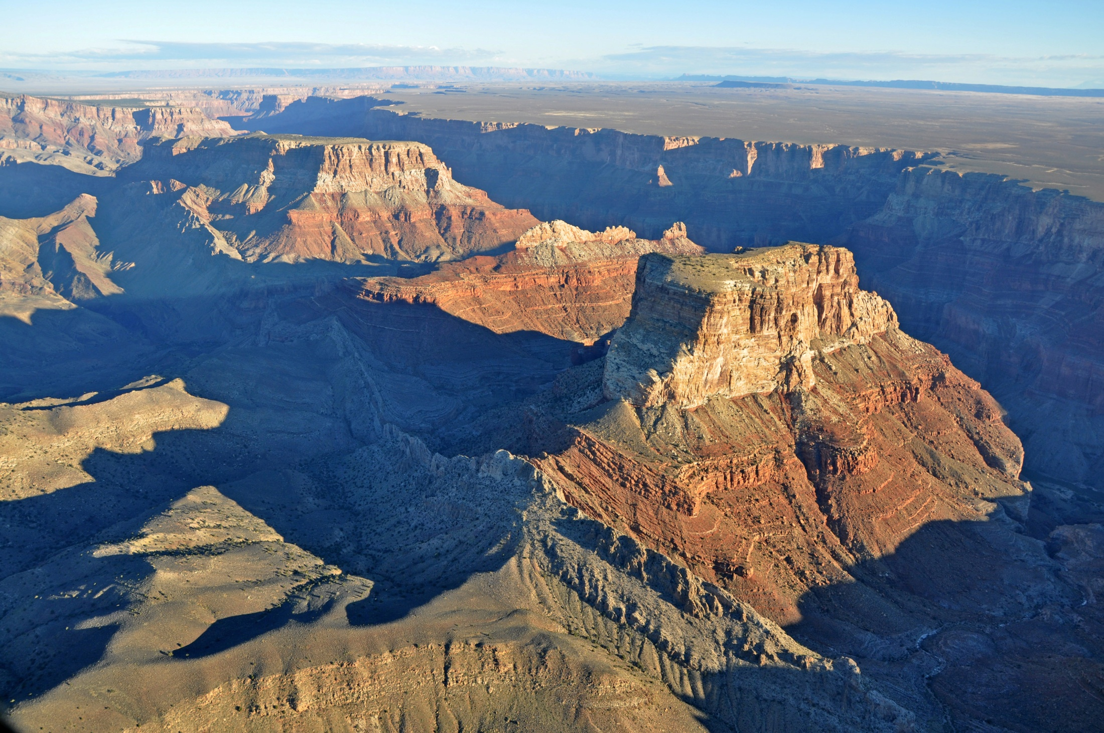
Notes:
Canyon/Deep and narrow valley with steep walls

Slide 20
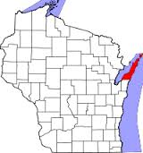
Notes:
Peninsula/Body of land jutting into a lake or ocean, surrounded on
three sides by water

Slide 21
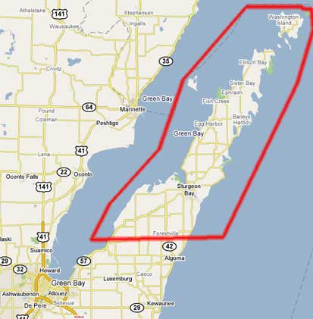

Slide 22
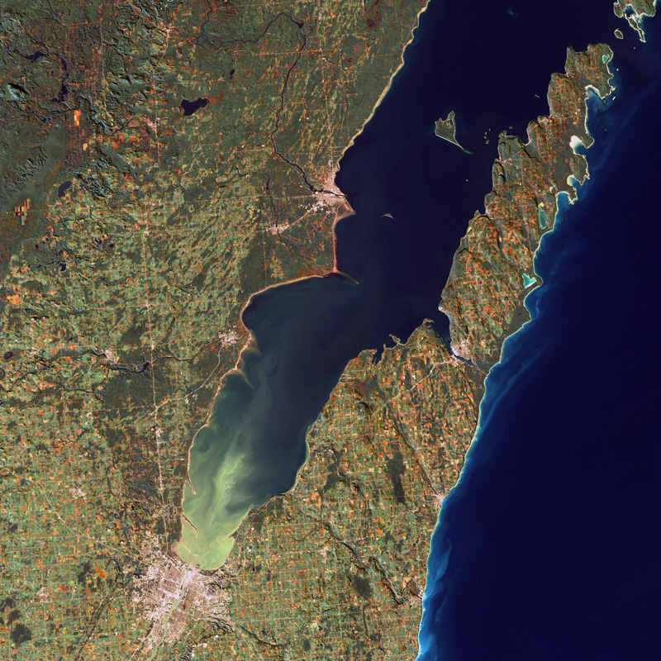

Slide 23
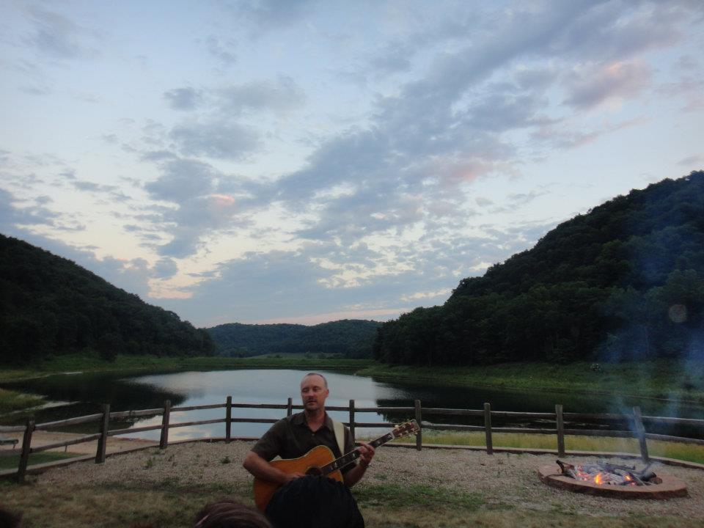
Notes:
Valley/Area of low land usually between hills or mountains

Slide 24
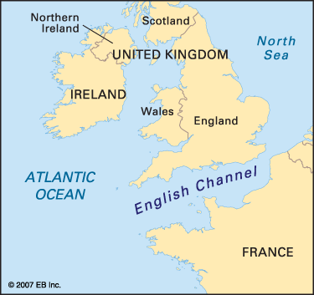
Notes:
Channel/Wide, strait or waterway between two landmasses that lie
close to each other; deep part of a river or other waterway

