Slide 1
Origins of the Roman Empire
Timeline
509 - 264 BCE
Romans defeat Etruscans in Italy and establish a REPUBLIC
264 - 44 BCE
Control all of Italy. Fighting wars to defend boundaries (5char?) (r)EPUBLICAN government still
44 BCE – 14 CE:
Julius Caesar – goes against the republic and names himself as Emperor. Rome becomes an EMPIRE
14 CE to about4 or 500 CE:
Several EMPERORS rule. They rule until they die. Eventually in 4-500 CE, the entire Roman civilization disappears from history

Slide 2
POWER

Slide 3
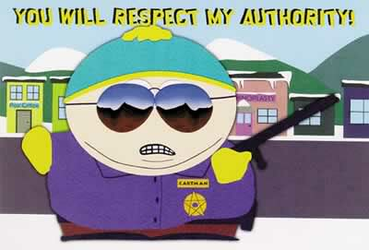

Slide 4
How To Label Years
BC/AD vs BCE/CE
Until recently, we counted years using the letters “BC” and “AD.”
These terms use the birth of Jesus Christ to be the year 0. Anything happening before Jesus’ birth, would be BC, or “before Christ.” Any year after Jesus’ death (including 2013), would be labeled AD or “after death.”
Notes:
Any problems? With this? Gap between jesus birth and death.
Anno Domini

Slide 5
How to Label Years
The correct way:
Since the 1980’s we’ve written years like this.
What used to be BC is now BCE – “Before Common Era”
Christ’s birth is still year 0.
But any year after Christ’s birth is now labeled CE simply for Common Era
So we always label years as 505 BCE – 14 CE… or 2013 CE
But anything that happened in the Ancient world is usually BCE
[example] EGYPT:
Old Kingdom - 2700 B.C.E. to 2200 B.C.E.
Middle Kingdom - 2055 B.C.E. to 1650 B.C.E.
New Kingdom - 1550 B.C.E. to 1070 B.C.E.

Slide 6
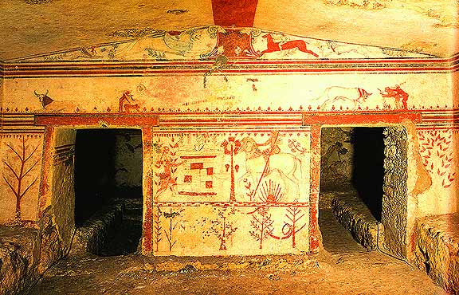
About 700-500 BCE
Italy is made up of several tribal groups.
One group, the ETRUSCANS, have a “King.”
but he can’t really control the other tribes, because they are nomadic. Meaning the tribes move around often building temporary settlements

Slide 8
Etruscans
Hunter-Gatherer group
Little is known about them
No literature, no original texts of religion have been found.
Only found tombs and dwellings

Slide 9
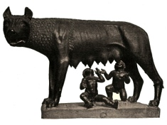
Origin Story of ROME

Slide 10
So What
509 – 264 BCE
The Romans kick out the Etruscans and plan to build their own city. A permanent settlement that would welcome people from every tribe across Italy. They would spend the next ~250 years defending their border and trying to conquer other parts of Italy
By 264 BCE, the Romans have gained control over all of Italy. All of Italy now becomes the roman republic.

Slide 12
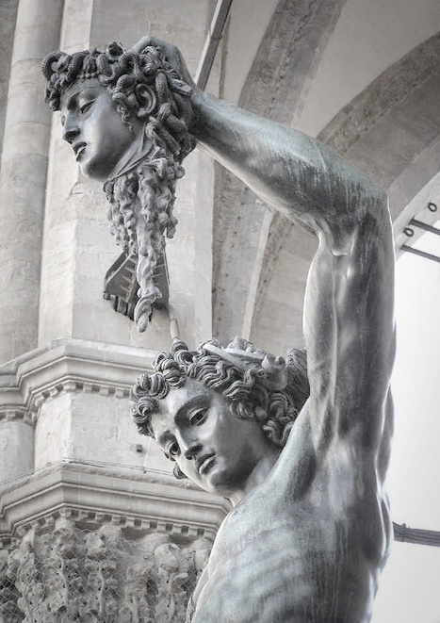
The Roman Republic
509 – 44 BCE
In Rome, they build the world’s first REPUBLIC.
republican government means: government with no king.
Govt is a “public matter” with representatives elected.
Notes:
is literally a form of government in which affairs of state are a "public matter" (Latin: res publica), not the private concern of the rulers, in which public offices are subsequently appointed or elected rather than privately accommodated, i.e. through inheritance or divine mandate. In modern times, the common definition of a republic is a government which excludes a monarch… For example, at the first decade of 21st century, Nepal was declared a Federal democratic Republic after abolishing its 240 years old monarchy on 28th of May 2008. Currently, 135 of the world's 206 sovereign states use the word "republic" as part of their official names.

Slide 13
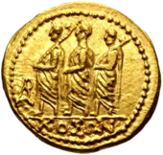
Roman Republic:
Government led by 2 CONSULS
Elected annually by the citizens
Inspiration for American Government:
The Roman Republic also had a large SENATE to advise the 2 consuls.
Power is shared
A Roman constitution gradually develops
Includes separation of power
Checks and balances

Slide 15
Roman Society
Like Egypt, Roman society was a caste system.
It was much more equal, however:
Patricians – land-owning, wealthy romans.
Plebians – citizen-commoners. Far more numerous.
All citizens would spend their lifetimes as soldiers and then as politicians.
Massive Slave-class. When Rome conquered another tribe, they would often take their people as slaves.
Notes:
Roman society was hierarchical.[2][3] The evolution of the Constitution of the Roman Republic was heavily influenced by the struggle between the patricians, Rome's land-holding aristocracy, who traced their ancestry back to the early history of the Roman kingdom, and the plebeians, the far more numerous citizen-commoners.
Over time, the laws that gave patricians exclusive rights to Rome's highest offices were repealed or weakened, and leading plebeian families became full members of the aristocracy.
The leaders of the Republic developed a strong tradition and morality requiring public service and patronage in peace and war, making military and political success inextricably linked.

Slide 16
The Republic: 264-44 BCE
Fighting Civil Wars to expand territory.
All over the Italian peninsula.
Early imperialism
By the time Caesar takes over in 44 BCE, The Roman Republic controls
all of Italy
Greece
Parts of the Middle east
A small strip of N. Africa
And most of Europe, including all of modern Spain and France.

Slide 17
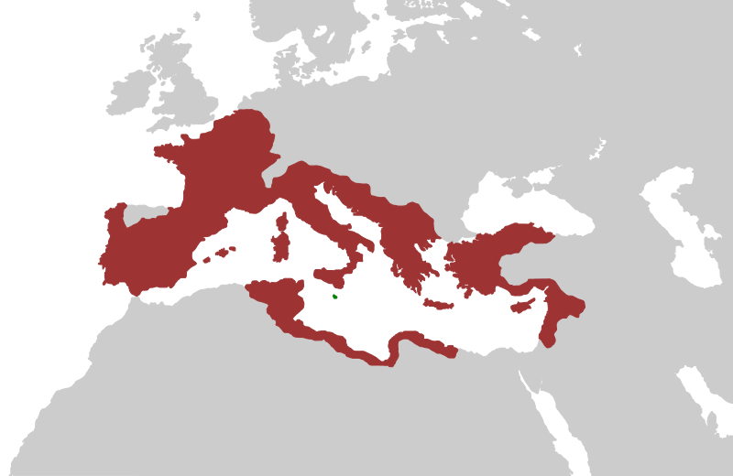
Roman Republic: Territory in 44 BCE (Caesar’s takeover)

Slide 18
Caesar Takes Over: 44 B.C.
WHY:
Roman government needs tax money to survive. Most people are slaves and cannot pay taxes.
The free, Roman citizens (plebians and patricians) were facing economic decline.
Romans see the senate as ineffective.
Caesar begins to argue that he take over sole power
Notes:
Julius Caesar was a great general and an important leader in ancient Rome. During his lifetime, he had held just about every important title in the Roman Republic including consul, tribune of the people, high commander of the army, and high priest. He suggested new laws, most of which were approved by the Senate. He reorganized the army. He improved the way the provinces were governed. The Romans even named a month after him, the month of July for Julius Caesar. When Julius Caesar said he had something to say, the people flocked to the Forum to hear his ideas. His ideas had been good ones. The people trusted him. Julius Caesar told the people that he could solve Rome's problems. Certainly, the Republic had problems. Crime was everywhere. Taxes were outrageous. People were hungry. Many were out of work. It was easier to use slaves to do work than hire Roman people, but the dependency on slave labor was causing Rome unemployment problem. The people were angry that their government had not been able to solve the many problems facing the Republic. Julius Caesar spoke publicly to the people about these problems, and promised to solve them if he could. The people supported Caesar. The people wanted to see Julius Caesar in a strong position of power so he could solve the problems facing the Republic. As Julius Caesar became more popular with the people, he also became more powerful.

Slide 19
Julius Caesar

Slide 20
Caesar Takes Over: So What?

Slide 21
Major Achievements of the Roman Republic
753-509 BCE:
Built political institutions like the FORUM
Won several civil wars to control and extend their borders in Italy.
Built the Circus Maximus
Developed a Roman Coin to be used in Rome and in all of their Italian territories.
Compitalia Fetsivals – invited all italians to come to Rome and party. Trying to unify and extend their control.
Notes:
Important religious institutions.

